Slide 1

AL AREEB ICT
Digital Transformation with clear purpose

Slide 2
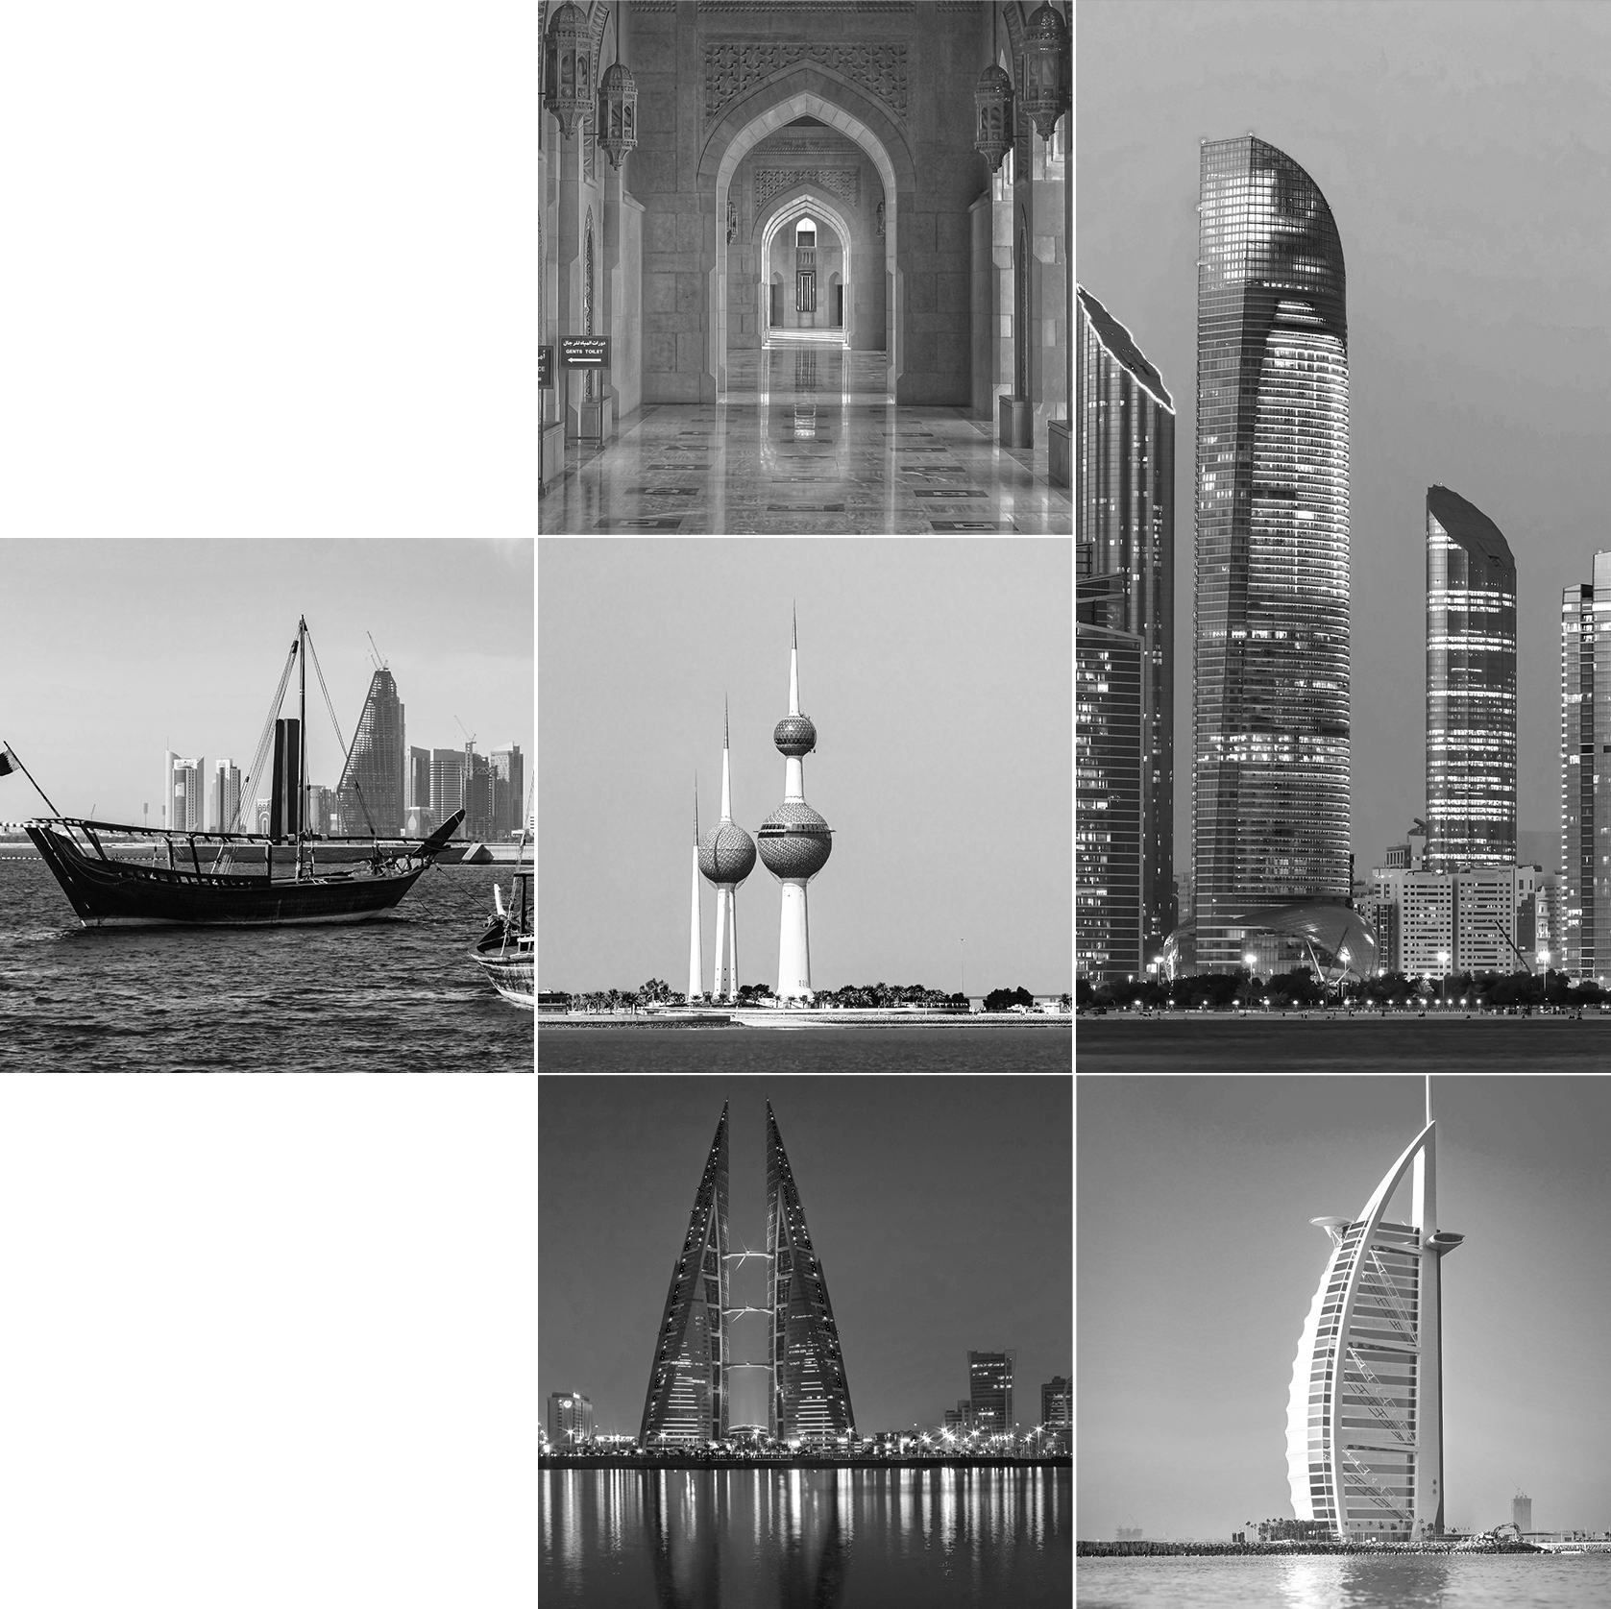
We, at Alareeb lCT, are committed to delivering quality products and services to our customers.
We are a process driven organization and believe in long-term relations, growth, profitability and sustainability with all our stakeholders.
As a Saudi Arabian
company, we serve the entirety of the GCC.
Abdullah alserhani
CEO AlareebICT
For Over Four Years,
Alareeb ICT has been assisting companies and government
organizations with a variety of IT and digital transformation services.
We realize the pace at which technology is transforming and how it impacts businesses let Alareeb ICT align your IT strategies with your organizational goals, leveraging current and future technological norms to ensure a seamless integration between the ideas, aspirations and actual solutions, services.
Al Areeb ICT PROFILE

Slide 3

3
2
1
Manage & Operate
Our 3-tiered
Approach
Sets you up for Digital Success
Strategize
Digital Transformation
Enablement
& Solutions
Strategize
Digital Transformation
Enablement
& Solutions
Digitize
Alareeb Software
lab
Manage & Operate
Cybersecurity&
Managed Services
Strategy & Road map
Strategy & Road map
PMO Project Management
Mobile Strategy
Enterprise Architecture
IoT, ML & AI
Web and Application
Development
Cybersecurity Assessments
Cloud Services
Outsource Digital Innovation & Application Development
SOC outsourcing
Strategize
Digitize
Digital Transformation is important for organization growth, without it, your company will not achieve the potential growth possible. This necessary transformation enables organizations to strive for an efficient taskforce, high-quality and full proof security, strengthened business alliances, faster and effective decision making.
To achieve this, they must embrace digital transformation and ensure fulfilment of their requirements.
Our robust digital transformation consulting services leverage the cutting-edge digital technologies to offer a competitive advantage over the rest. We propose a complete set of services that focus towards accelerating the organizational journey towards success, profitability and efficiency.
Govern & Control
?
Why
Digital Transformation
is Important for your Organization
Al Areeb ICT PROFILE

Slide 4

1
AlareebICT Service Categories
Strategize
Digital Transformation
Enablement
& Solutions
Strategize
Digital Transformation
Enablement
& Solutions
Digitize
Alareeb Software
lab
Manage & Operate
Cybersecurity&
Managed Services
Strategy & Road map
PMO Project Management
Mobile Strategy
Enterprise Architecture
Digital Transformation Solutions
IoT, ML & AI
Web and Application
Development
Cybersecurity Assessments
Cloud Services
Outsource Digital Innovation & Application Development
SOC outsourcing
Strategize
Digitize
Manage & Operate
Digital Transformation Enablement
& Solutions
Alareeb Software lab
Cybersecurity & Managed Services
Our services guide clients through a structured process, from crafting a robust strategic roadmap to navigating a seamless system launch. We tailor solutions to seamlessly integrate with your organizational culture and objectives, ensuring digital strategies that deliver enduring value.
Al Areeb ICT PROFILE

Slide 5
1
2
3
Strategize
Digital Transformation
Enablement
& Solutions
Digitize
Alareeb Software
lab
Manage & Operate
Cybersecurity&
Managed Services
Strategy & Road map
PMO Project Management
Mobile Strategy
Enterprise Architecture
Digital Transformation Solutions
IoT, ML & AI
Web and Application
Development
Cybersecurity Assessments
Cloud Services
Outsource Digital Innovation & Application Development
SOC outsourcing
Strategy & Road map
Begins with a thorough analysis of various factors including.
Digital Transformation Platform and Strategy Development
Digital Transformation Roadmap
Strategy realization
Current business strategy
IT infrastructure
Investment
Best practices
Competitive landscape
Employee
Customer needs
Fully alinged to business strategy
Map roadmap components to value chain
Strategic initiative with clear objectives
High level business case for each initiative
Phased approach
Minimize change resistance
Quickwins
Continuous Value realization
Program governance
Change management
We work with you to develop a strategy that aligns with your organizational goals, business methodologies, and budget.
Al Areeb ICT PROFILE

Slide 6
1
2
3
Strategize
Digital Transformation
Enablement
& Solutions
Digitize
Alareeb Software
lab
Manage & Operate
Cybersecurity&
Managed Services
Strategy & Road map
PMO Project Management
Mobile Strategy
Enterprise Architecture
Digital Transformation Solutions
IoT, ML & AI
Web and Application
Development
Cybersecurity Assessments
Cloud Services
Outsource Digital Innovation & Application Development
SOC outsourcing
PMO Project Management
IT Project and Program Management
Project Management
Office Assistance
Project Portfolio Management Enhancement / Implementation
Achieve your objectives efficiently, especially for complex and time-sensitive projects
PMO Maturity
Evaluation
Software Evaluation & Deployment
Comprehensive PMO Deployment
Al Areeb ICT PROFILE

Slide 7
1
2
3
Strategize
Digital Transformation
Enablement
& Solutions
Digitize
Alareeb Software
lab
Manage & Operate
Cybersecurity&
Managed Services
Strategy & Road map
PMO Project Management
Mobile Strategy
Enterprise Architecture
Digital Transformation Solutions
IoT, ML & AI
Web and Application
Development
Mobile Strategy
Enhance & boost sales through mobile app development
Better customer
experience
Develop the right market penetration approach
Develop mobile apps that meet your expectations and elevate your brand image
Build a direct
marketing channel
Better connections
with customers
Boost brand knowledge
& recognition
Al Areeb ICT PROFILE

Slide 8

1
2
3
Strategize
Digital Transformation
Enablement
& Solutions
Digitize
Alareeb Software
lab
Manage & Operate
Cybersecurity&
Managed Services
Strategy & Road map
PMO Project Management
Mobile Strategy
Enterprise Architecture
Digital Transformation Solutions
IoT, ML & AI
Web and Application
Development
Managed Services
Outsource Digital Innovation & Application Development
SOC outsourcing
Enterprise Architecture
Break down silos & reduce transformation complexity
Get your business-IT alignment done
Make smarter business
decisions faster
Allocate organizational assets more efficiently
Enterprise Architecture services for strategic alignment of IT and business objectives.
Improve governance of your organizational assets
Design & deliver your best future architecture
Increase enterprise agility
Reduce costs & maximize value
Al Areeb ICT PROFILE

Slide 9

1
2
3
Strategize
Digital Transformation
Enablement
& Solutions
Digitize
Alareeb Software
lab
Manage & Operate
Cybersecurity&
Managed Services
Strategy & Road map
PMO Project Management
Mobile Strategy
Enterprise Architecture
Digital Transformation Solutions
IoT, ML & AI
Web and Application
Development
Cybersecurity
Assessments
Managed Services
Outsource Digital Innovation & Application Development
SOC outsourcing
Digital Transformation Solutions
Convert All Your Paper Documents Into A User-friendly Digital Format.
Elimination of paper forms
Easily create e-Forms without programming knowledge
e-Form that loads faster than any other forms
Reduction in administration and manpower
Speeding up overall processes
Reduce Your ZATCA Compliance Risk To Zero, By Switching Your Invoicing System To Taxilla.
Easy migration
Intelligent dashboards for tracking
Sign directly on the platform
Zero Non-compliant risk
Supports Arabic language
The world is constantly in motion and as it turns, things evolve with our partners.
Al Areeb ICT PROFILE

Slide 10
1
2
3
Strategize
Digital Transformation
Enablement
& Solutions
Digitize
Alareeb Software
lab
Manage & Operate
Cybersecurity&
Managed Services
Strategy & Road map
PMO Project Management
Mobile Strategy
Enterprise Architecture
Digital Transformation Solutions
IoT, ML & AI
Web and Application
Development
Cybersecurity
Assessments
Managed Services
Outsource Digital Innovation & Application Development
SOC outsourcing
ML
IOT
Ai
Make Predictive Models
IOT, ML & AI
Improve Operational Efficiency
Enabling Businesses To Forecast Trends
Automate And Optimize Business Processes
Unlocks new opportunities for growth by integrating IoT, ML, and AI
Reduce Costs
Optimize Operations
Personalized Customer Experiences
Enhance
Decision-making Capabilities
Make Data-driven Decisions
Valuable Insights From Your Data
Al Areeb ICT PROFILE

Slide 11
1
2
3
Strategize
Digital Transformation
Enablement
& Solutions
Digitize
Alareeb Software
lab
Manage & Operate
Cybersecurity&
Managed Services
Strategy & Road map
PMO Project Management
Mobile Strategy
Enterprise Architecture
IoT, ML & AI
Web and Application
Development
Cybersecurity
Assessments
Managed Services
Outsource Digital Innovation & Application Development
SOC outsourcing
Cybersecurity Partner
Web & Application Development
Ideation using
design thinking
Discovery Product
Road Map
Feasability Assessment
Solution Design
Agile Software Development
Solution Development
Testing
Deploy
Ensure optimal solutions catered to your unique business needs
Al Areeb ICT PROFILE

Slide 12
1
2
3
Strategize
Digital Transformation
Enablement
& Solutions
Digitize
Alareeb Software
lab
Manage & Operate
Cybersecurity&
Managed Services
Strategy & Road map
PMO Project Management
Mobile Strategy
Enterprise Architecture
IoT, ML & AI
Web and Application
Development
Cybersecurity
Assessments
Managed Services
Outsource Digital Innovation & Application Development
SOC outsourcing
Cybersecurity Partner
Cybersecurity Assessments
Identify vulnerabilities & weaknesses in your systems
Penetration
Testing
IT Security
Solutions
Protect your business against cybersecurity threats.
Proactive
Defense
Personalized recommendations & support
Al Areeb ICT PROFILE

Slide 13
1
2
3
Strategize
Digital Transformation
Enablement
& Solutions
Digitize
Alareeb Software
lab
Manage & Operate
Cybersecurity&
Managed Services
Strategy & Road map
PMO Project Management
Mobile Strategy
Enterprise Architecture
IoT, ML & AI
Web and Application
Development
Cybersecurity
Assessments
Managed Services
Outsource Digital Innovation & Application Development
SOC outsourcing
Cybersecurity Partner
Managed Services
Service Management
Application Management
Cyber Security Management
Managed Services are designed
to cater to various business needs covering
Incident Management: record, assign, track, monitor and close reports of unplanned interruptions to service
Problem Management: perform root cause analysis around recurring incidents
Service Level Agreements (SLAs)
Release Management
Request Management
Level 2 Break Fix: Consists of incidents escalated from Level 1 Service Desk
Application Monitoring
Preventative Maintenance
Batch Operations
Non-Production Environment Synchronisations
Advanced Security Solutions: include managed firewalls, anti-malware software, intrusion detection systems, web filtering, access management, MFA, and patch management
Security Information and Event Management (SIEM): tracks security-related incidents within your IT environment
Dedicated Security Analysts
Threat Hunting
Incident Response and Investigation
Security Training
Compliance Support
Multiple Levels Support
Continuous Enhancement & Improvement
Information & Cyber Security Controls
Al Areeb ICT PROFILE

Slide 14
1
2
3
Strategize
Digital Transformation
Enablement
& Solutions
Digitize
Alareeb Software
lab
Manage & Operate
Cybersecurity&
Managed Services
Strategy & Road map
PMO Project Management
Mobile Strategy
Enterprise Architecture
IoT, ML & AI
Web and Application
Development
Cybersecurity
Assessments
Managed Services
Outsource Digital Innovation & Application Development
SOC outsourcing
Cybersecurity Partner
Outsource Digital Innovation & Application Development
Software
Development
Infrastructure
Management
Cloud
Services
IT Outsourcing
& Managed Services
Bring your idea,
and we build it for you
Al Areeb ICT PROFILE

Slide 15
1
2
3
Strategize
Digital Transformation
Enablement
& Solutions
Digitize
Alareeb Software
lab
Manage & Operate
Cybersecurity&
Managed Services
Strategy & Road map
PMO Project Management
Mobile Strategy
Enterprise Architecture
IoT, ML & AI
Web and Application
Development
Cybersecurity
Assessments
Managed Services
Outsource Digital Innovation & Application Development
SOC outsourcing
Cybersecurity Partner
SOC outsourcing
24/7 Monitoring
& Threat Detection
Incident Response To Mitigate
& Manage Security Threats
Vulnerability
Management
Security Operations Center (SOC) service, acts as a critical line of defense for our clients against cyber threats.
Compliance
Reporting
Threat
Intelligence
Proactive & Reactive Strategies
Al Areeb ICT PROFILE

Slide 16
1
2
3
Strategize
Digital Transformation
Enablement
& Solutions
Digitize
Alareeb Software
lab
Manage & Operate
Cybersecurity&
Managed Services
Strategy & Road map
PMO Project Management
Mobile Strategy
Enterprise Architecture
IoT, ML & AI
Web and Application
Development
Cybersecurity
Assessments
Managed Services
Outsource Digital Innovation & Application Development
SOC outsourcing
Cybersecurity Partner
Cybersecurity Partner
Odyssey empowers customers to build an effective and applicable Cybersecurity Strategy
ClearSkies™ Threat
& Vulnerability Management Platform
Managed Security / Detection & Response (MS/DR) Services
Advisory Services
Integrated Solutions
Cloud Security
Al Areeb ICT PROFILE

Slide 17
Unlock new value for your business with AlareebICT's expert guidance.
We empower you to:
1
2
3
AL Areeb
Re-imagine transformation
Strategize
Digital Transformation
Enablement
& Solutions
Digitize
Alareeb Software
lab
Manage & Operate
Cybersecurity&
Managed Services
Strategy & Road map
PMO Project Management
Mobile Strategy
Enterprise Architecture
IoT, ML & AI
Web and Application
Development
Cybersecurity
Assessments
Managed Services
Outsource Digital Innovation & Application Development
SOC outsourcing
Transformation drives success and we mitigate the challenges that comes along with it.
The challenge is successfully orchestrating continuous change.
Strategic Intent
+ Culture
?
Partner with AlareebICT and unleash the power of Digital Transformation for your business.
Business &
Operating MODEL
Leadership
Systems
Organization Design
Workforce
WAYS OF Working
Transformation Management + Change
Al Areeb ICT PROFILE

Slide 18
Alareeb ICT
Digital Transformation Value
Unlock new value for your business with AlareebICT's expert guidance.
We empower you to:
Streamline operations: Boost efficiency, reduce costs, and optimize workflows.
Enhance customer experience: Deliver seamless, personalized interactions across channels.
Drive innovation: Embrace cutting-edge technologies to stay ahead of the curve.
Gain agility and scalability: Adapt to changing market demands with ease.
Empower your workforce: Equip your team with the tools and skills for digital success.
?
Partner with AlareebICT and unleash the power of Digital Transformation for your business.
Al Areeb ICT PROFILE

Slide 19

Will your Company
Grow
?
Without
a Digital
Transformation
Al Areeb ICT PROFILE

Slide 20

Our
Recent
Success
Stories
Al Areeb ICT PROFILE
Notes:
The rest are the same

Slide 21

Some Of Our Clients
1
As a trusted partner we have been selected by Taajeer Financing Company to be their Software Development Partner. During the continual agreement we are going to mange and create the financial products like Tawarrq, Consumer Loan, Auto lease..etc. Besides provides the support and development teams, product innovation and continual integration with banks services, government services, payment services besides ensure the compliance with SAMA IT governance regulations and Cyber Security regulation. All of that done by applying Alareeb Software Development Approach.
The Project Covered The Following:
Build Software Development CI/CD environments. And integrate it through the cloud or local hosting.
Build the Mobile Product Development Roadmap and backlog requirements
Provide continues development and product releases through Agile approach
Running and providing the technical operation and maximizing the business value by applying continual improvement
Al Areeb ICT PROFILE

Slide 22


Some Of Our Clients
2
Scrubs Valley is one of Alareeb products that developed with the Healthcare sector and provides solutions to hospitals and caregivers to match the resourcing planning and utilizing the healthcare practitioners to fill the scarcity and the demand in the market and optimize the operational cost.
The solution was developed by using Agile Development approach, applying DevOps processes to ensure continual delivery of the features and responding to the rapid change with cost optimization controllers.
The Project Covered The Following:
Build Software Development CI/CD environments. And integrate it through the cloud or local hosting.
Build the Mobile Product Development Roadmap and backlog requirements
Provide continues development and product releases through Agile approach
Running and providing the technical operation and maximizing the business value by applying continual improvement
Al Areeb ICT PROFILE

Slide 23

Some Of Our Clients
3
Tuwayq is one of the innovative products that developed by Alareeb development team to provide a holistic platform for SMEs’ that help them to digitize their relationship with the customers and provide the tools and third-party integration with shipping companies and payments gateways.
Alareeb utilizes modern techniques to develop an integration hub that manage the products, customers, financial processes and increase the company's market share. Alareeb provides the continuous improvement and development besides carrying the operational effort.
The Project Covered The Following:
Build Software Development CI/CD environments. And integrate it through the cloud or local hosting.
Build the Mobile Product Development Roadmap and backlog requirements
Provide continues development and product releases through Agile approach
Running and providing the technical operation and maximizing the business value by applying continual improvement
Al Areeb ICT PROFILE

Slide 24


Some Of Our Clients
4
SAICO is one of the leading corporate insurance companies in KSA. SIACO was looking for a partner to assist them in assessing their IT, Cyber Security and Business Continuity.
Alareeb partnered with SAICO and conducted a detailed assessment. evidence collection and provided a recommendation and implementation roadmap as per SAMA regulations and produced a detailed findings report for ISO 20000, ISO 27000, ISO 22301, SAMA CSF, SAMA IT Governance and SAMA BCM regulations. In addition to that, Alareeb has also conducted a detailed assessment to SAICO’s cybersecurity vulnerability and compromise in both SAICO’s firewalls, Active Directory and Databases.
PMO: Mohammed AlShahrani
The Project Covered The Following:
ISO 20000 – IT Governance
ISO 27000 – Cyber Security
ISO 22301 – Business Continuity
SAMA Cyber Security Framework
Database Assessment
Firewall Assessment
Compromise and Vulnerability Assessment
Business Continuity Awareness and Coaching
Al Areeb ICT PROFILE

Slide 25
Some Of Our Clients
5
Taajeer Finance has put an ambitious business strategy for the next 5 years to transform the company to a FinTech enabled organization and IPO ready.
Alareeb partnered with Taajeer Finance to build their Digital Transformation Strategy and design their Future IT Organization Operating model. Alareeb also has set a detailed Digital Transformation Roadmap for Taajeer to elevate their digital maturity level so they can achieve their business strategy and objectives aligned with Vision 2030 and international trends in the FinTech industry worldwide.
The Project Covered The Following:
ERP and CRM Assessment and Requirement analysis
Enterprise Architecture
Digital Presence and Digital Channels assessment and requirement analysis
Compliance with SAMA governance and regulations requirements
Assess Current IT Operating Model
Al Areeb ICT PROFILE

Slide 26


Some Of Our Clients
6
Al Romansiah is looking to replace their existing back-end and POS solution in all their restaurants and branches.
Alareeb partnered with Al Romansiah throughout their journey from understanding and documenting their detailed business and technical requirements and assessing the technologies in the market for both ERP/CRM solution. Alareeb has conducted a detailed evolution and assessment technically and functionality as well as commercial and TCO for picking the right solution for Al Romansiyah
The Project Covered The Following:
Analyze and document business and technical requirements for ERP and CRM implementations
Draft RFIs and RFP
Conduct Solution Demos
Evaluate and negotiate technical and commercial proposals
Assess Al Romansiah’s readiness for implementation
Al Areeb ICT PROFILE

Slide 27

Some Of Our Clients
7
Taajeer Auto, one of Taajeer Group companies and leading the market in FOO and MG Car sales in KSA was looking for a consulting services to improve their business processes.
Alareeb provided a lean-led business process optimization for Taajeer Auto Sales, After Sales and Maintenance departments. The outcome of the project guaranteed a high cost recoverability with increased productivity without the need to hire new resources. The project has produced future business processes and detailed roadmap for Taajeer for implementation.
The Project Covered The Following:
Conduct detailed as-is business process assessment.
Site surveys and dealership visits to assess sales cycles.
Calculate current waste in sales, after sales and maintenance business cycles.
Estimate the ROI of implementing and digitizing future business processes.
Al Areeb ICT PROFILE

Slide 28


Some Of Our Clients
8
Capitalizing on Alareeb's success at CAAPP, CSPPE is a new and ambitious Poultry Co-Ups in the eastern region who has requested from Alareeb to build their end-to-end business strategy.
Alareeb has worked with CSPPE to establish their first business strategy that would ensure their optimized start up with minimal cost and maximum return on investment in the first early years with a clear plan to acquire market share in the poultry industry.
Alareeb has also advocated CSPPE on the importance of Digital Transformation and produced a Digital Transformation Strategy as a subset of their business strategy for the next 5 years.
The Project Covered The Following:
Marketing Strategy
Sales and Distribution Strategy
Transportation and Fleet Strategy
Production Strategy
Supply Chain Management Strategy
Digital and IT Strategy
Finance and Financing Strategy
Al Areeb ICT PROFILE

Slide 29

Some Of Our Clients
9
CAAPP is one of the leading poultry producers with 5% of market share in KSA. CAAPP has partnered with Alareeb to build their Business Strategy for the next 5 years.
Focusing on increasing profit and optimizing costs, Alareeb assisted CAAPP in shaping their Business Strategy for the next 5 years centered on adapting the latest digital technologies that would assist CAAPP in minimizing the waste in operations, leveraging digital channels and solutions for workforce optimization and make CAAPP an IPO ready organization once they have implemented the strategy
The Project Covered The Following:
Conduct business framework canvas workshops
Conduct market scan and evaluate competition and produce SOWT analysis
Assess digital and IT status
Develop detailed project cards and implementation roadmap
Design financial dynamics what-if scenario models
Al Areeb ICT PROFILE

Slide 30

Helping You Meet All Your Digital Transformation Goals
We have the expertise, experience and are looking forward to your digital journey. Let us put together a custom package of what you need to succeed in this digital age.
info@alareebict.com
+966 11 486 8359
+966 11 686 8359
www.alareebict.com
Riyadh, Kingdom of Saudi ArabiaDist
Office 5 , Al Muhammadiyah Building , Alkhaznh Street , lshbiliyah

